Slide 1


Slide 2
Hello again, Human! I hope you enjoy your journey until here. Now, you know what IoT is, but where is it in our daily life? Can you think if you have any IoT device at home? I am sure you will have at least one ☺
I am going to show you 4 examples of IoT usage and how they work in a high level ☺

Slide 3
Have you ever thought that your smart watch is an IoT device?
Fitbit
Fitbit –Smart device with sensors
Fitbit is a worldwide well known IoT wearable which tracks day by day activities.
Fitbit is a smart device with embedded sensors. It can collect and compute data extracted by itself.
The Fitbit app running in a smartphone has a dashboard to track activity, record workouts, log food, connect with friends and family & more.
Bluetooth
Smartphone – device

Slide 4

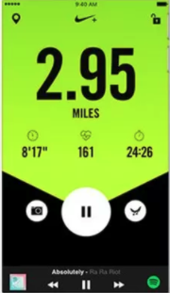
Have you ever thought how runners are tracked? Is it only about crossing the finish line? No! They measure a lot more: pace, distance, route, etc. How they measure it? Have a look in this example!
Nike+
Nike+ tracks the performance of runners through a wireless connection.
Components: the Nike+ sensor, a pair of shoes compatible with Nike+ and a tracking device.
Nike+ sensor is not a smart device, it is only a sensor. It can collect data, but it cannot compute the data extracted by itself, which means that a device is needed to manage the data.
Smartphone – device
Wireless
Nike+ - Sensor

Slide 5
I will sit a bit, so many examples to tell you! I got tired ☺
Alexa
Do you know my girlfriend Alexa? She is so smart! She can help you to automate your home! I am so in love with her!
Alexa is a virtual assistant technology developed by Amazon
It is capable of voice interaction, music playback, making to-do lists, setting alarms, streaming podcasts, playing audiobooks, and providing weather, traffic, sports, and other real-time information, such as news.
Smart devices with sensors
Alexa controls smart devices using itself as a home automation system. Users are able to extend the Alexa capabilities by installing "skills" (additional functionality developed by third-party vendors, in other settings more commonly called apps, such as weather programs and audio features).

Slide 6
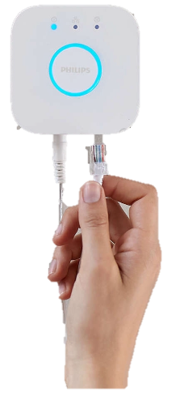
What can I tell you about Philips Hue… He is a light DJ, a bit snobbish, but a good guy. If you need a light improvement in your house, you can call him ;)
Philips Hue
Smart devices with sensors
Philips Hue is a line of color changing LED lamps and white bulbs which can be controlled wirelessly.
The Phillips Hue line of bulbs comprises smart bulbs which can have a sensor embedded.
The Philips Hue Bridge is the central controller of the lighting system, which allows the smart bulbs to "communicate" with a Smartphone (App).
Hue Bridget

Slide 7
I hope you have learned something new!
Now think about your life: where can you find more smart devices, or sensors, or controllers. I am sure you will find other examples!
See you in task 1.4! ☺
Don’t be lazy! You are improving very fast!
You receive 100 bars for finishing Task 1.3

